Slide 1
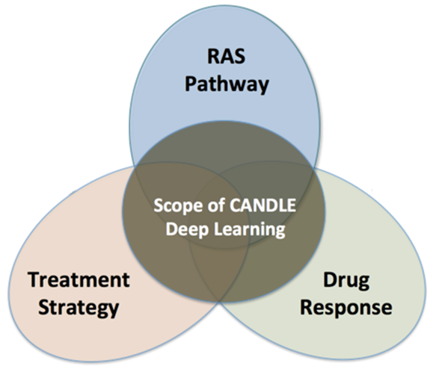
CANDLE: CANcer DistrIButed Learning Environment
Scalable workflows for deep learning
drhgfdjhngngfmhgmghmghjmghfmf
Justin m wozniak
MCS Division
wozniak@mcs.anl.gov
Many slides courtesy of Rick Stevens, CANDLE PI
PathForward meeting @ AMD — October 24, 2017

Slide 2
OUTLINE
Application cases
Workflow technologies
Initial performance results
Requirements

Slide 3
Application cases

Slide 4
Driving integration of Simulation, Data Analytics and Machine Learning
Traditional
HPC
Systems
Scalable
Data Analytics
Large-Scale
Numerical
Simulation
CORAL Supercomputers
and Exascale Systems
Deep
Learning

Slide 5
CANDLE Goals
Develop an exascale deep learning environment for cancer
Building on open source deep learning frameworks
Optimization for CORAL and exascale platforms
Support all three pilot project needs for deep learning
Collaborate with DOE computing centers, HPC vendors and ECP co-design and software technology projects
Mission statement: Enable the most challenging deep learning problems in cancer research to run on the most capable supercomputers in the DOE

Slide 6
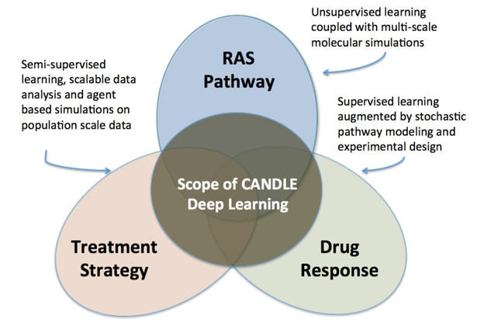
CANDLE OVERVIEW
Three key cancer problems:

Slide 7
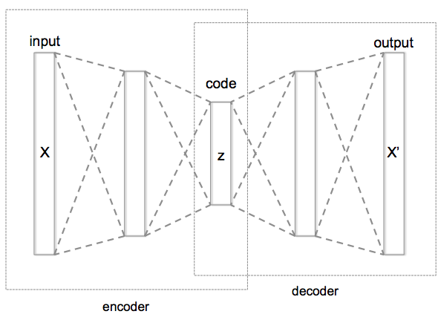
P1B1: Autoencoder Compressed Representation for Gene Expression
Overview: Given a sample of gene expression data, build a sparse autoencoder that can compress the expression profile into a low-dimensional vector
Relationship to core problem: Many molecular assays generate large numbers of features that can lead to time-consuming processing and over-fitting in learning tasks; hence, a core capability we intend to build is feature reduction
Expected outcome: An autoencoder that collapse high dimensional expression profiles into low dimensional vectors without much loss of information

Slide 8
P1B1: Benchmark Specs Requirements
Description of the Data
Data source: RNA-seq data from GDC
Input dimensions: 60,484 floats; log(1+x) transformed FPKM-UQ values
Output dimensions: Same as input
Latent representation dimension: 1000
Sample size: 5,000
Notes on data balance and other issues: unlabeled data draw from a diverse set of cancer types
Expected Outcomes
Reconstructed expression profiles
Output range: float; same as log transformed input
Evaluation Metrics
Accuracy or loss function: mean squared error
Expected performance of a naïve method: landmark genes picked by linear regression
Description of the Network
Proposed network architecture: MLP with encoding layers, dropout layers, bottleneck layer, and decoding layers
Number of layers: At least two hidden layers in encoding and decoding
Annotated Keras Code
Data loader, preprocessing, basic training and cross validation, prediction and evaluation on test data

Slide 9
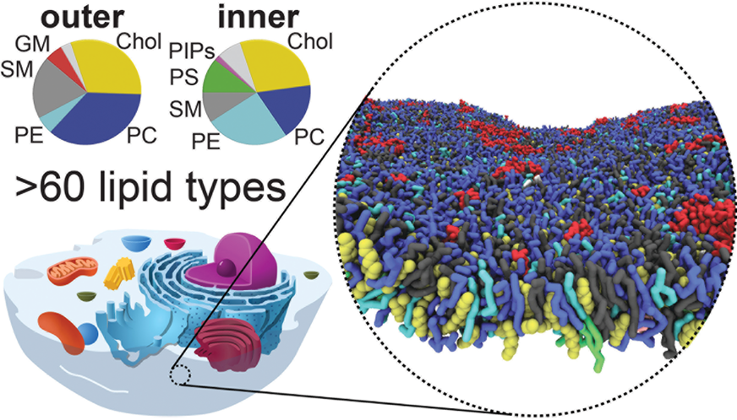
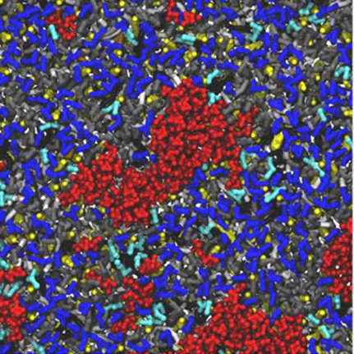
P2B1: Autoencoder
Goal: Generate automatically extracted features representing molecular simulation data
Relationship to core problem: Establish framework for building future tools using learned features
Expected outcome: Improvement in the understanding of protein formation and easing of the handling large-scale molecular dynamics output
Lipid Organization of the Plasma Membrane
Helgi I. Ingólfsson et al.
J. Am. Chem. Soc., 2014, 136 (41), pp 14554–14559

Slide 10
P2B1: Benchmark Specs Requirements
Description of the Data
Data source: MD Simulation output as PDB files
Input dimensions: ~1000x1000 per time step
Output dimensions: 500
Latent representation dimension
Sample size: O(10⁷) time steps
Notes on data balance and other issues: unlabeled data with rare events
Expected Outcomes
Reconstructed MD simulation state
Output range: automatically learned features that discriminate the data set
Evaluation Metrics
Accuracy or loss function: L2 reconstruction error
Expected performance of a naïve method: N/A
Description of the Network
Proposed network architecture: stacked fully-connected autoencoder
Number of layers: 5-8
Annotated Keras Code
Data loader, preprocessing, basic training and cross validation, prediction and evaluation on test data

Slide 11
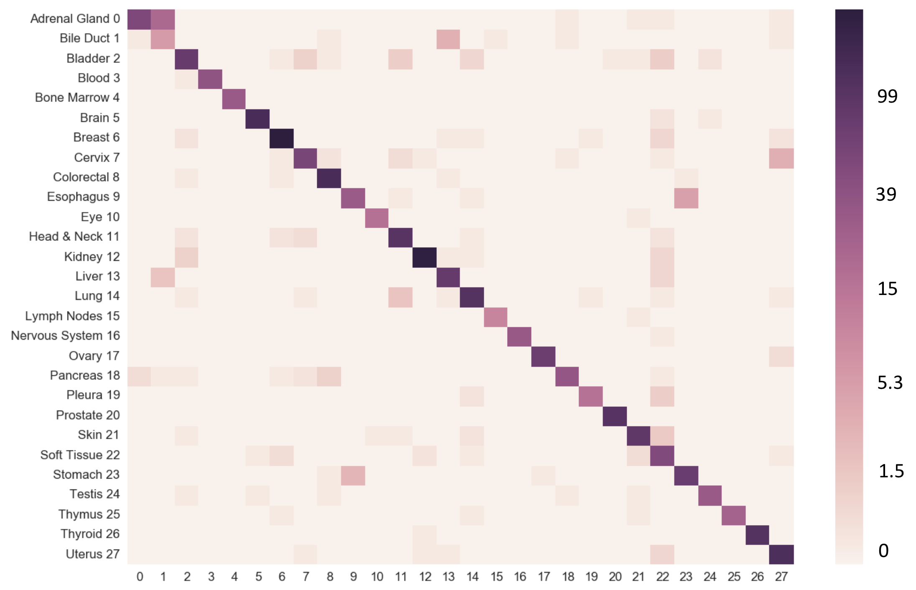
P1B2: Sparse Classifier Disease Type Prediction from Somatic SNPs
Overview: Given tumor somatic SNPs, build a deep learning network that can classify the cancer type
Relationship to core problem: Exercise two core capabilities we need to build: (1) classification based on very sparse input data; (2) evaluation of the information content and predictive value in a molecular assay with auxiliary learning tasks
Expected outcome: DNN that can classify sparse data

Slide 12
P1B2: Benchmark Specs Requirements
Description of the Data
Data source: SNP data from GDC MAF files
Input dimensions: 2.7 million [unique SNPs], or 28,205 [aggregated variation impact by gene]
Output dimensions: 10 class probabilities (9 most abundant cancer types in GDC + 1 “others”)
Sample size: 5,000
Notes on data balance and other issues: data balance achieved via undersampling; “others” category drawn from all remaining lower-abundance cancer types in GDC
Expected Outcomes
Classification
Output range or number of classes: 10
Evaluation Metrics
Accuracy or loss function: Standard approaches such as F1-score, accuracy, ROC-AUC, etc.
Expected performance of naïve method: linear regression or random forest without feature selection
Description of the Network
Proposed network architecture: MLP, ~5 layers
Annotated Keras Code
Data loader, preprocessing, basic training and cross validation, prediction and evaluation on test data

Slide 13
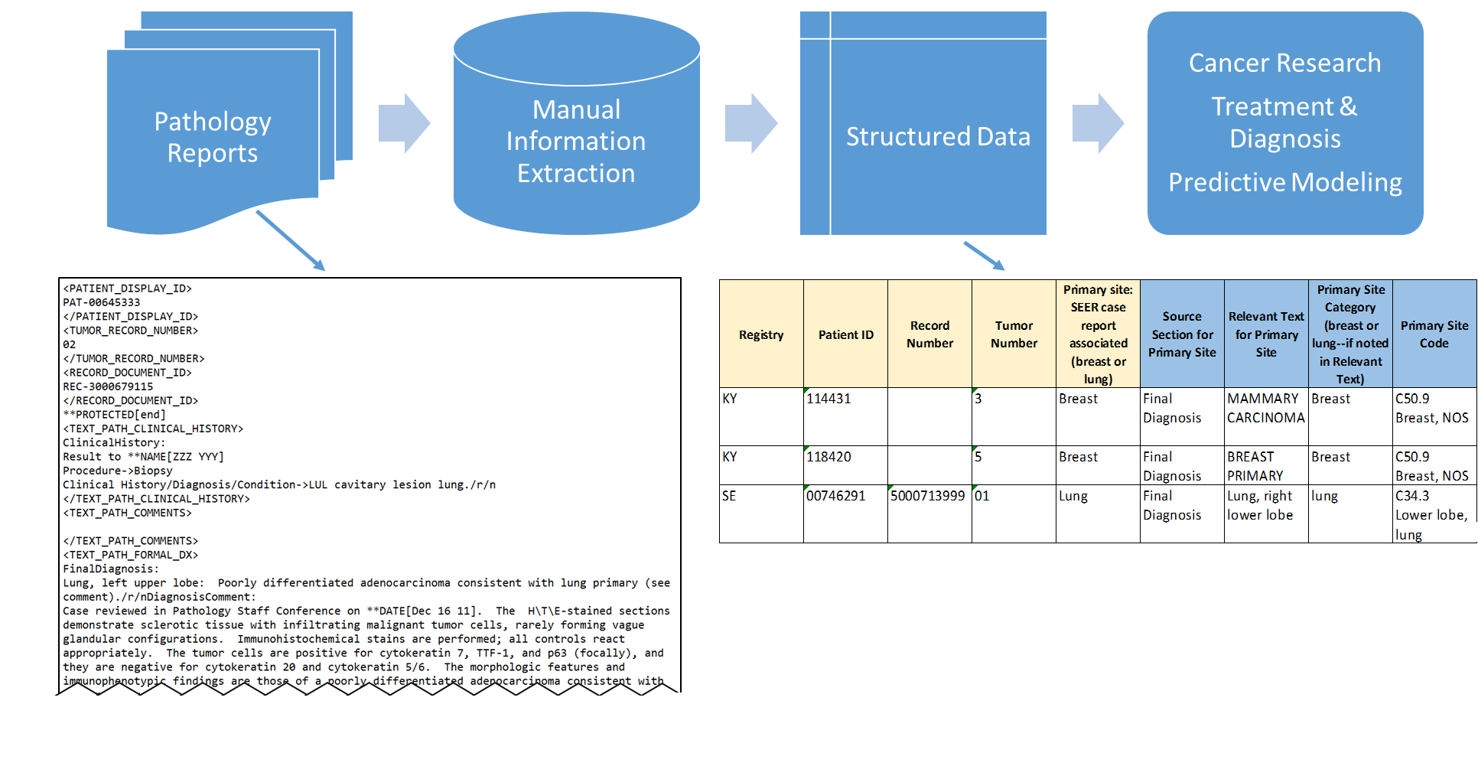
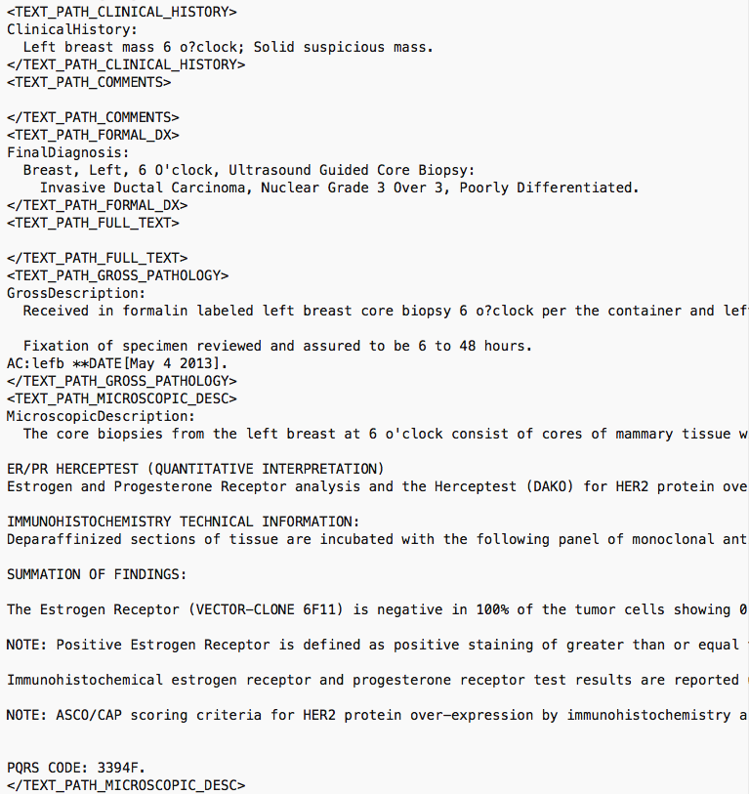
P3B1: RNN-LSTM: Generative models for Path Reports
Overview: Given a sample corpus of biomedical text such as clinical reports, build a deep learning network that can automatically generate synthetic text documents with valid clinical context
Relationship to core problem: Labeled data is quite challenging to come by, specifically for patient data, since manual annotations are time consuming; hence, a core capability we intend to build is a “gold-standard” annotated data that is generated by deep learning networks to tune our deep text comprehension applications
Expected outcome: A generative RNN based on LSTMs that can effectively generate synthetic biomedical text of desired clinical context
location of tumor
type of tumor

Slide 14
P3B1: Benchmark Specs Requirements
Description of the Data
Data source: Annotated pathology reports
Input dimensions: 250,000-500,000 [characters], or 5,000-20,000 [bag of words], or 200-500 [bag of concepts]
Output dimensions: Same as input
Sample size: O(1,000)
Notes on data balance and other issues: standard NLP pre-processing is required, including (but not limited to) stemming words, keywords, cleaning text, stop words, etc. Data balance is an issue since the number of positive examples vs. control is skewed
Expected Outcomes
A generative model for pathology reports
Output range: N/A, since the outputs are actual text documents with known case descriptions/ concepts
Evaluation Metrics
Accuracy or loss function: Standard information theoretic metrics such as log-likelihood score, minimum description length score, AIC/BIC to measure how similar actual vs. generated documents are
Expected performance of a naïve method: Latent Dirichlet allocation (LDA) models
Description of the Network
Proposed network architecture: LSTM with at least 4 layers and [128, 256, 512] character windows
Number of layers: At least two hidden layers with one input and one output sequence
Annotated Keras Code
Data loader, preprocessing, basic training and cross validation, prediction and evaluation on test data

Slide 15
Parallelism strategies
10,000 x 10-1000 x 10-100 = 1M – 1000M processing elements
Hyperparameter Search: up to ~10,000x
Depends on search strategy
Data Parallel: 10x-1000x
Data Parallel
10x-1000x
Model
Parallel
10x-100x
Model
Parallel
10x-100x
Model
Parallel
10x-100x
Model
Parallel
10x-100x
Model
Parallel
10x-100x
...
...
...

Slide 16
WORKFlow technologies

Slide 17
CANDLE Software Stack
Hyperparameter Sweeps,
Data Management (e.g. DIGITS, Swift, etc.)
Workflow
Network description, Execution scripting API
(e.g. Keras, Mocha)
Scripting
Tensor/Graph Execution Engine
(e.g. Theano, TensorFlow, LBANN-LL, etc.)
Engine
Architecture Specific Optimization Layer
(e.g. cuDNN, MKL-DNN, etc.)
Optimization

Slide 18
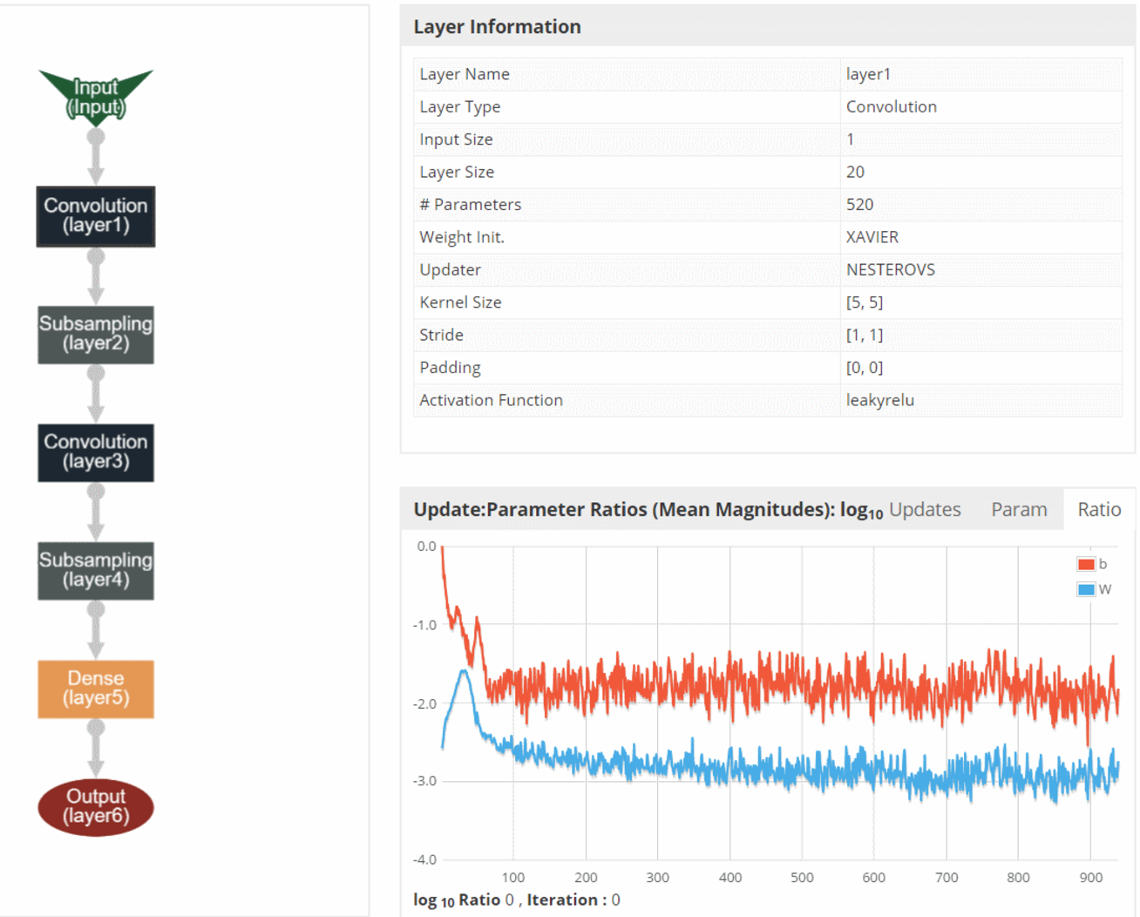
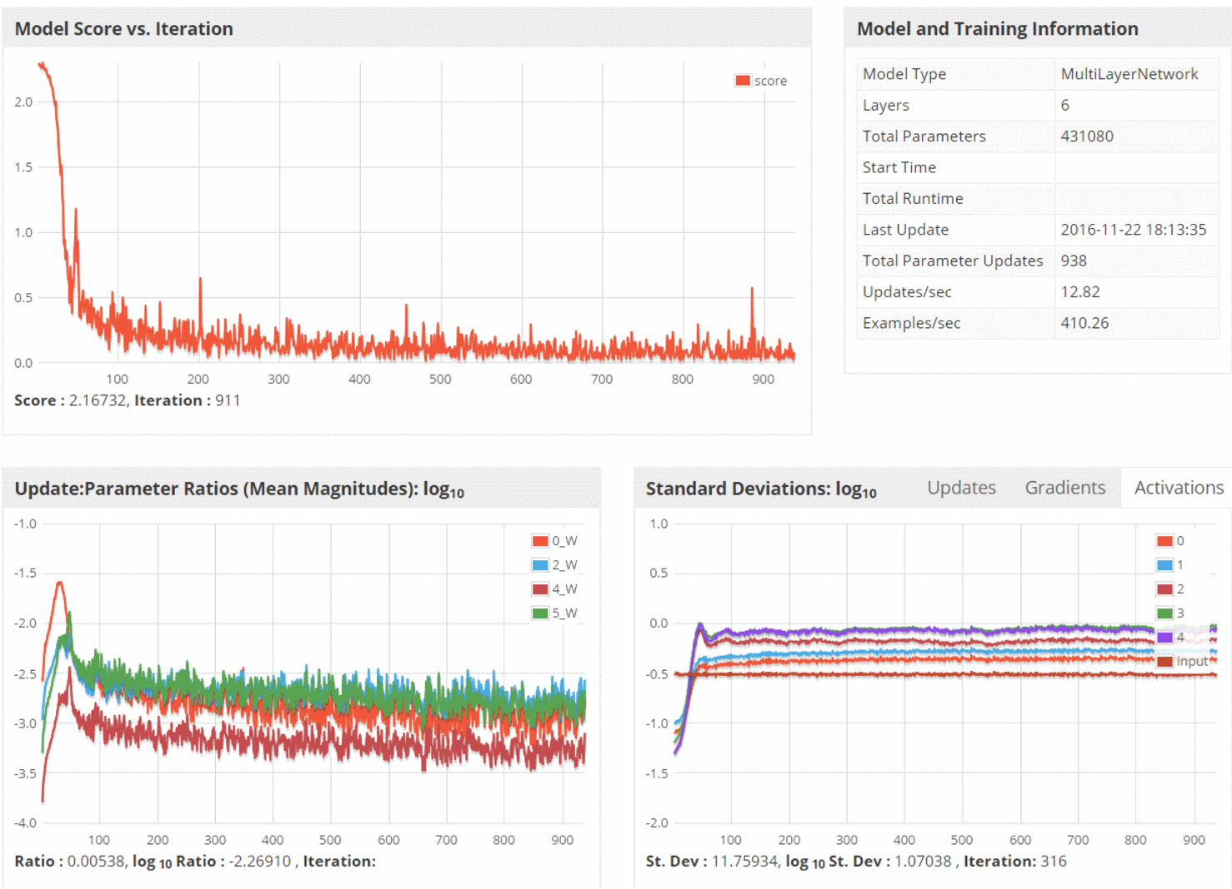
CANDLE System Overview
ML/DL Benchmarks
Pilot 1
Pilot 2
Pilot 3
CANDLE Database
CANDLE Specifications
Benchmark Spec
Hyperparameter Spec
Hardware Spec
Metadata Store
Model Store
Integrator Website
Benchmarks
Datasets
Models
Experiments
Runs
Model Descriptions
CANDLE Supervisor
Model Weights
Hyperparameter Optimization Frameworks
Hyperopt, mlrMBO, Spearmint
Workflow Manager
(Swift-T EMEWS)
Data API
ALCF
Theta, Cooley
NERSC
Cori
OLCF
Titan, SummitDev
Hardware Resources

Slide 19
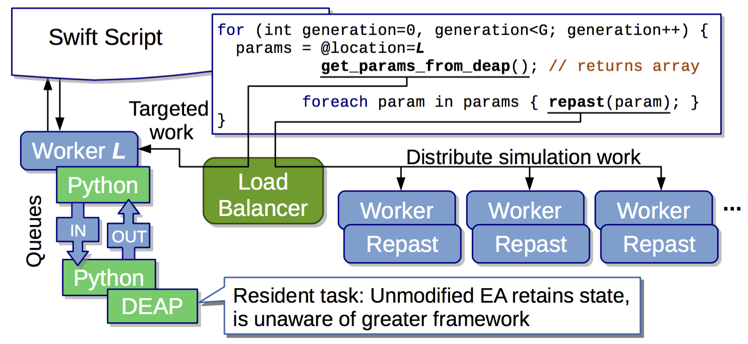
EMEWS: Extreme-scale model exploration workflows in Swift/T
To query the state of the EA, we designate one worker on location L for exclusive use by DEAP.
http://www.mcs.anl.gov/~emews/tutorial

Slide 20
Language goals
Hierarchical, naturally parallel, script-like programming
Make it easy to run large batteries of external program or library executions
Provide rich programming language at the top level – fully generic
Support implicit concurrency and conventional programming constructs
Enable complex tasks based in other scripting languages (e.g., Python) or parallel MPI tasks
Other powerful features- rich data types, resource management, …

Slide 21
The Swift programming model
All progress driven by concurrent dataflow
(int r) myproc (int i, int j)
{
int x = F(i);
int y = G(j);
r = x + y;
}
F() and G() implemented in native code or external programs
F() and G()run in concurrently in different processes
r is computed when they are both done
This parallelism is automatic
Works recursively throughout the program’s call graph

Slide 22
Swift syntax
Data types
int i = 4;
string s = "hello world";
file image<"snapshot.jpg">;
Shell access
app (file o) myapp(file f, int i)
{ mysim "-s" i @f @o; }
Structured data
typedef image file;
image A[];
type protein_run {
file pdb_in; file sim_out;
}
bag<blob>[] B;
Conventional expressions
if (x == 3) {
y = x+2;
s = strcat("y: ", y);
}
Parallel loops
foreach f,i in A {
B[i] = convert(A[i]);
}
Data flow
merge(analyze(B[0], B[1]),
analyze(B[2], B[3]));
Swift: A language for distributed parallel scripting. J. Parallel Computing 2011
Compiler techniques for massively scalable implicit task parallelism. Proc. SC 2014

Slide 23
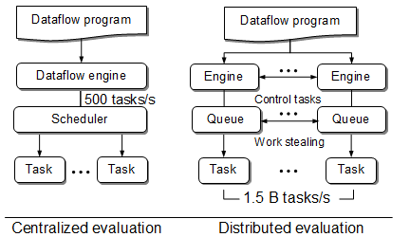
Centralized evaluation is a bottleneck at extreme scales
Had this (Swift/K):
Now have this (Swift/T):
Turbine: A distributed-memory dataflow engine for high performance many-task applications. Fundamenta Informaticae 28(3), 2013

Slide 24
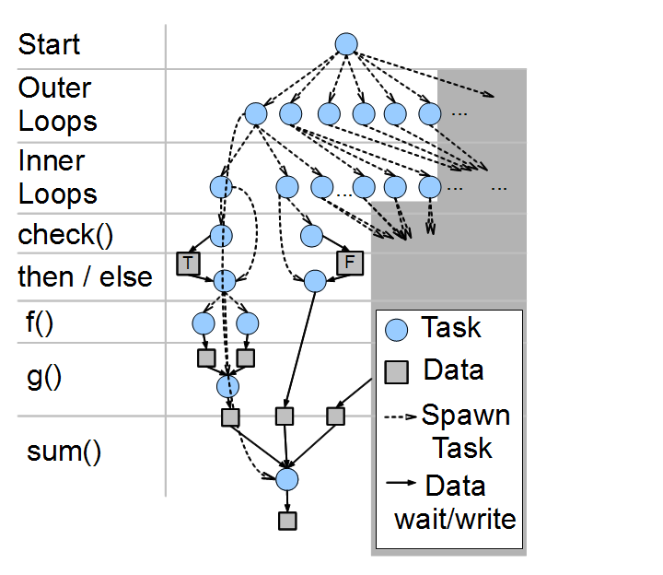
Swift/T: Fully parallel evaluation of complex scripts
int X = 100, Y = 100;
int A[][];
int B[];
foreach x in [0:X-1] {
foreach y in [0:Y-1] {
if (check(x, y)) {
A[x][y] = g(f(x), f(y));
} else {
A[x][y] = 0;
}
}
B[x] = sum(A[x]);
}
Swift/T: Scalable data flow programming for distributed-memory task-parallel applications . Proc. CCGrid, 2013.

Slide 25

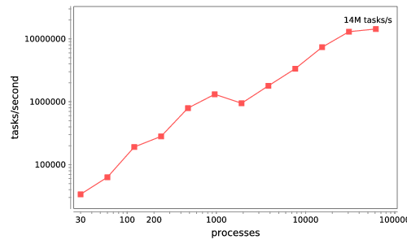






Swift/T: Enabling high-performance Scripted workflows
Supports tasks written in many languages
Write site-independent scripts
Automatic parallelization and data movement
Run native code, script fragments as applications
Rapidly subdivide large partitions for MPI jobs
Move work to data locations
Swift/T worker
Swift/T control process
Swift worker process
Swift control process
C
C++
Fortran
Swift control process
C
C++
Fortran
C
C++
Fortran
MPI
64K cores of Blue Waters
2 billion Python tasks 14 million Pythons/s
Interlanguage parallel scripting for distributed-memory scientific computing. Proc. WORKS @ SC 2015

Slide 26
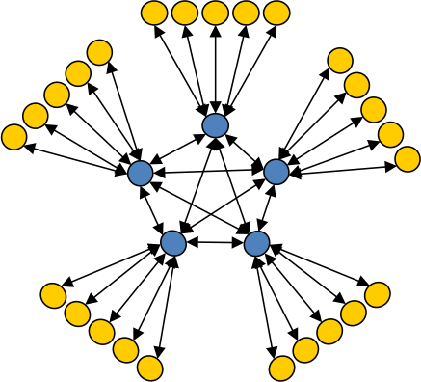
Asynchronous Dynamic Load Balancer
ADLB for short
workers
An MPI library for master-worker workloads in C
Uses a variable-size, scalable network of servers
Servers implement work-stealing
The work unit is a byte array
Optional work priorities, targets, types
For Swift/T, we added:
Server-stored data
Data-dependent execution
masters
Lusk et al. More scalability, less pain: A simple programming model and its implementation for extreme computing. SciDAC Review 17, 2010

Slide 27
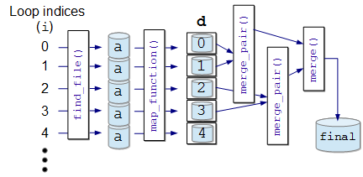
Mapreduce in swift/t
file d[];
int N = string2int(argv("N"));
// Map phase
foreach i in [0:N-1] {
file a = find_file(i);
d[i] = map_function(a);
}
// Reduce phase
file final <"final.data"> = merge(d, 0, tasks-1);
(file o) merge(file d[], int start, int stop) {
if (stop-start == 1) {
// Base case: merge pair
o = merge_pair(d[start], d[stop]);
} else {
// Merge pair of recursive calls
n = stop-start;
s = n % 2;
o = merge_pair(merge(d, start, start+s),
merge(d, start+s+1, stop));
}
}
The user needs to implement map_function() and merge()
These may be implemented in native code, Python, etc.
Could add annotations
Could add additional custom application logic
Big data staging with MPI-IO for interactive X-ray science. Proc. Big Data Computing, 2014

Slide 28
Features for Big Data analysis
Location-aware scheduling User and runtime coordinate data/task locations
Collective I/O User and runtime coordinate data/task locations
Application Dataflow, annotations
Application I/O hook
Runtime MPI-IO transfers
Runtime Hard/soft locations
Distributed data
Distributed data
Parallel FS
F. Duro et al. Experimental evaluation of a flexible I/O architecture for accelerating workflow engines in ultrascale environments. Parallel Computing, 2017.

Slide 29
Task locations
User-written annotation on function call
Swift/T provides a hostmap library that maps host names to MPI ranks
User annotation sends function to rank:
Useful for data-intensive applications or leaf functions with state
Soft locations: allow queued tasks to be stolen and execute anywhere
Want to automate this in some cases with the @heavy syntax
foreach i in 0:N-1 {
location L = hostmap_lookup(“file”+i);
@location=L f(i);
}
foreach i in 0:N-1 {
location L = hostmap_lookup(“file”+i);
@location=(L, SOFT) f(i); }

Slide 30
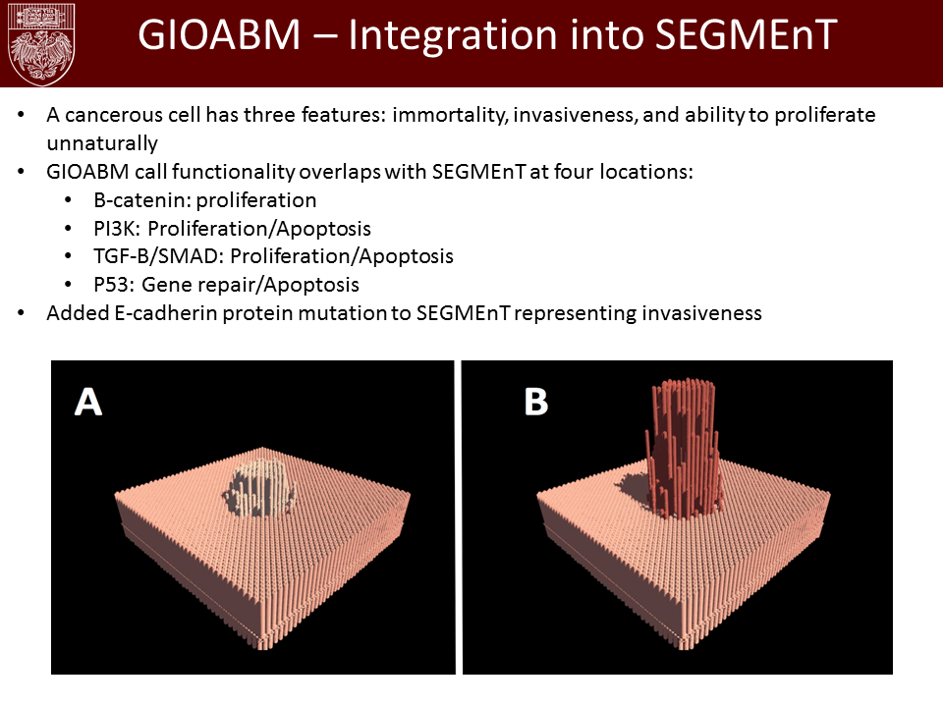
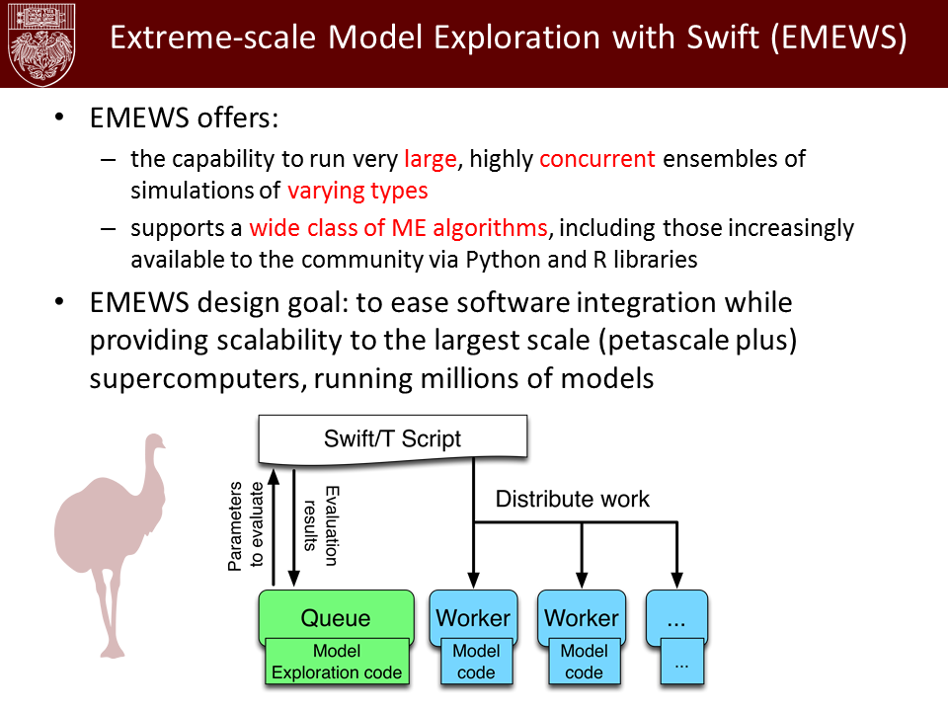
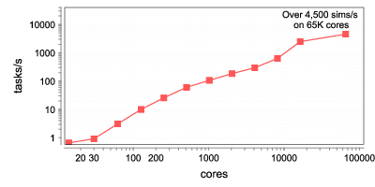
U. Chicago hospitals: Cancer Ensembles
Best paper at SC Cancer Workshop 2016
Parameter fitting for biological phenomenon (DNA repair rate) via massive scale evolutionary algorithm in Swift/T framework
Anatomic-scale cancer modeling using the Extreme-scale Model Exploration with Swift (EMEWS) framework. Proc. CACW @ SC, 2016

Slide 31
INITIAL PERFORMANCE RESULTS

Slide 32
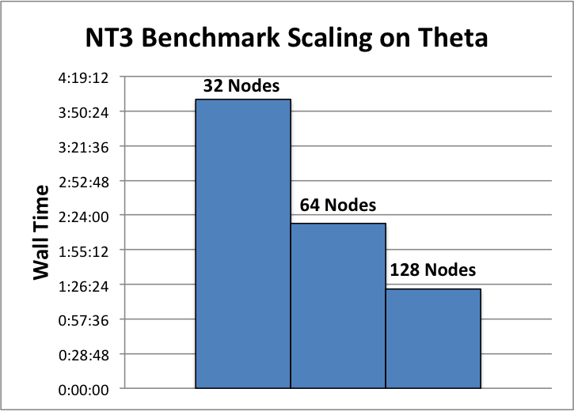
Manycore scalability result

Slide 33
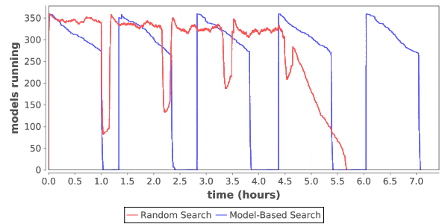
Load over time for search
Typical load plot for NT3 workflow on Cori

Slide 34
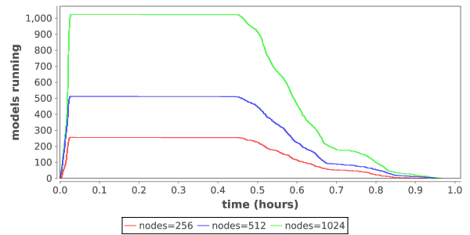
Ramp up / ramp down
Zoom in on single iteration on Titan

Slide 35
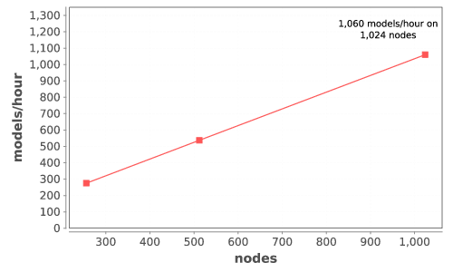
scaling hyperparameter search
Scaling models/hour on Titan

Slide 36
Requirements

Slide 37
Notes on requirements
Simulation Applications
64bit floating point
Memory Bandwidth
Random Access to Memory
Sparse Matrices
Distributed Memory jobs
Synchronous I/O multinode
Scalability Limited comm
Low Latency High Bandwidth
Large Coherency Domains help sometimes
O typically greater than I
O rarely read
Output is data
Big Data Applications
64 bit and Integer important
Data analysis Pipelines
DB including No SQL
MapReduce/SPARK
Millions of jobs
I/O bandwidth limited
Data management limited
Many task parallel
Large-data in and Large-data out
I and O both important
O is read and used
Output is data
Deep Learning Applications
Lower Precision (fp32, fp16)
FMAC @ 16 summing to 32
Inferencing can be 8 bit (TPU)
Scaled integer possible
Training dominates dev
Inference dominates pro
Reuse of training data
Data pipelines needed
Dense FP typical SGEMM
Small DFT, CNN
Ensembles and Search
Single Models Small
I more important than O
Output is models

Slide 38
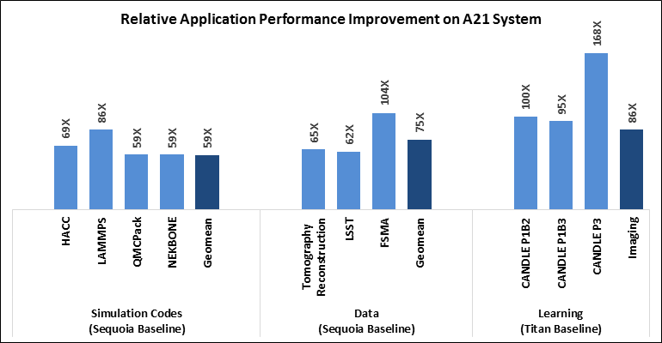
Performance Targets for Exascale

Slide 39
QUESTIONS?

Slide 40
Thanks
CANDLE Team:
Rick Stevens, Tom Brettin, Gina Tourassi, Arvind Ramanathan, Fred Streitz, Brian Van Essen, Tanmoy Bhattacharya, Jamal Mohd-Yusof, Cristina Garcia Cardona, Prasanna Balaprakash, Eric Stahlberg, Fangfang Xia, Maulik Shukla, Emily Dietrich, Jonathan Ozik, Nick Collier, Rajeev Jain, John Bauer, Matthew Baughman, Harry Yoo, and others
Code and guides:
CANDLE GitHub: https://github.com/ECP-CANDLE
Swift/T Home: http://swift-lang.org/Swift-T

